Slide 1
Capstone Project
Online Retail Customer Segmentation
Suvendu Nayak
cohort Geneva

Slide 2
Problem Statement:
In this project, your task is to identify major customer segments on a transnational data set which contains all the transactions occurring between 01/12/2010 and 09/12/2011 for a
UK-based and registered non-store online retail.The company mainly sells unique all-occasion gifts. Many customers of the company are wholesalers.

Slide 3

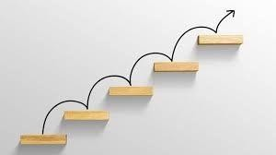
Key Steps:
Defining the problem statement
Data Cleaning
EDA and data visualization
Data preprocessing
Feature selection
Preparing Dataset for model
Applying model
Model validation and selection

Slide 4
Why is analytics useful for Customer segmentation ?
To know Recency of customers.
To know Frequency of customers.
To know Monetary Value of customers.

Slide 5
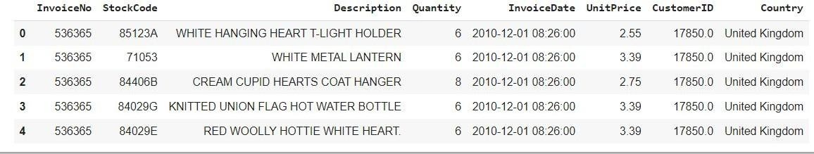
Dataset :
Rows : 541909
Columns : 8

Slide 6
Variable Names:
InvoiceNo: Invoice number. Nominal, a 6-digit integral number uniquely assigned to each transaction. If this code starts with letter 'c', it indicates a cancellation.
StockCode: Product (item) code. Nominal, a 5-digit integral number uniquely assigned to each distinct product.
Description: Product (item) name. Nominal.
Quantity: The quantities of each product (item) per transaction. Numeric.
InvoiceDate: Invoice Date and time. Numeric, the day and time when each transaction was generated.
UnitPrice: Unit price. Numeric, Product price per unit in sterling.
CustomerID: Customer number. Nominal, a 5-digit integral number uniquely assigned to each customer.
Country: Country name. Nominal, the name of the country where each customer resides.

Slide 7
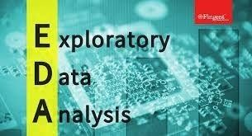
Exploratory Data Analysis:
EDA is used to analyze what the data can tell us before the modeling or by applying any set of instructions/code.

Slide 8
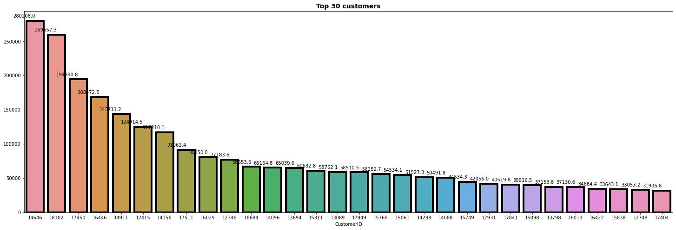
Top 30 customers:

Slide 9
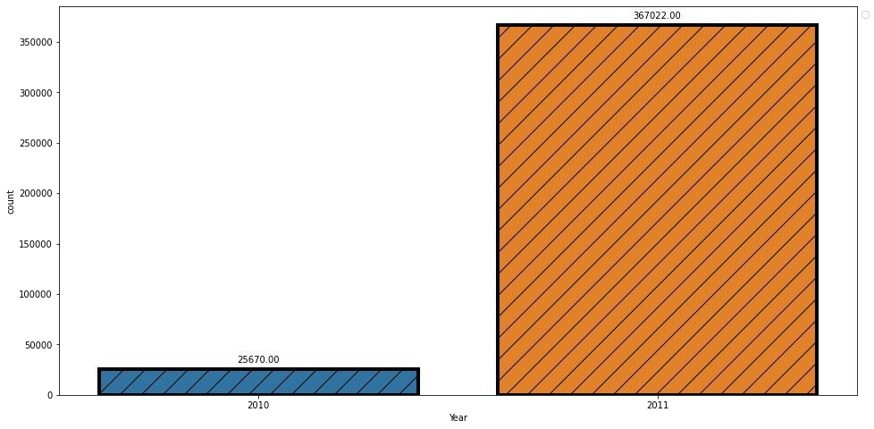
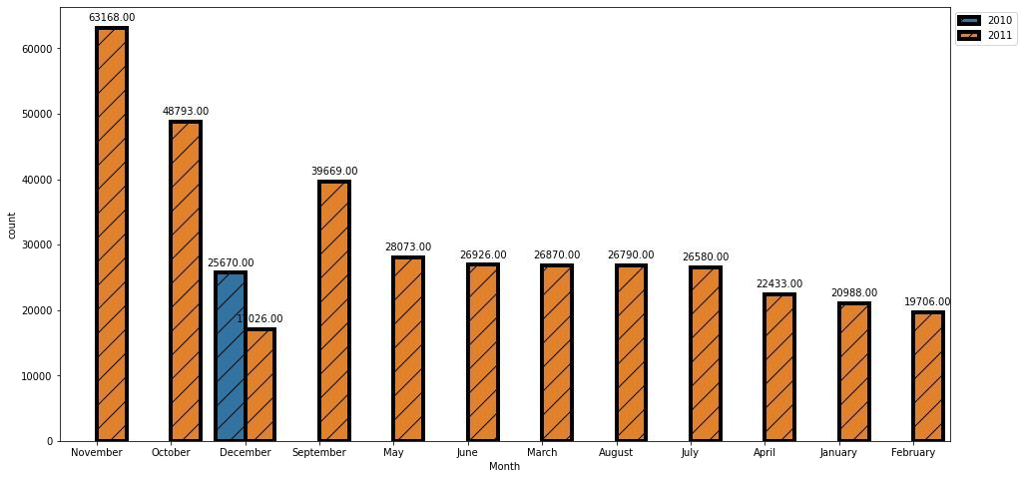
Periodical purchasing stats:
Here we can see huge spike in 2011 this is because we only have december months data from 2010.
we can see there is huge sale in the month of october and november.

Slide 10
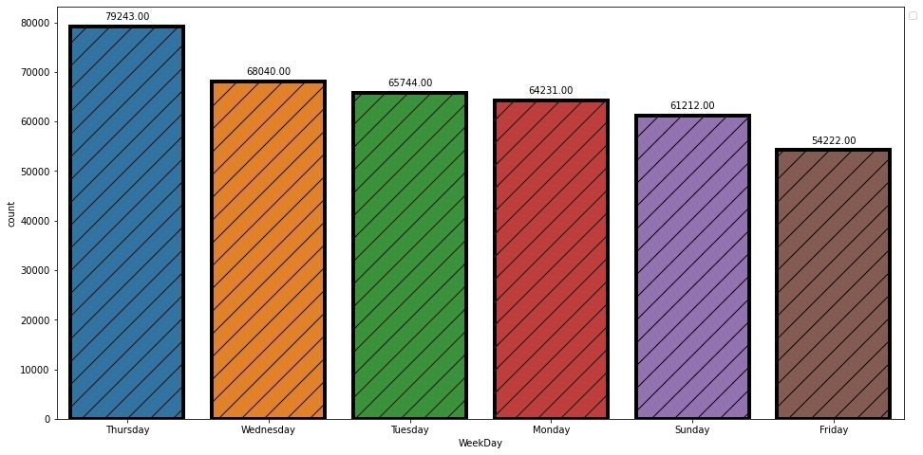
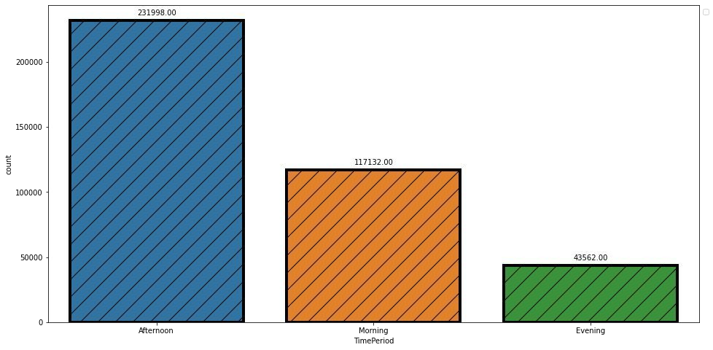
Periodical purchasing stats:
we can see on wednesday and thursday there is more sale
we can see people are buying on afternoon time period more.

Slide 11
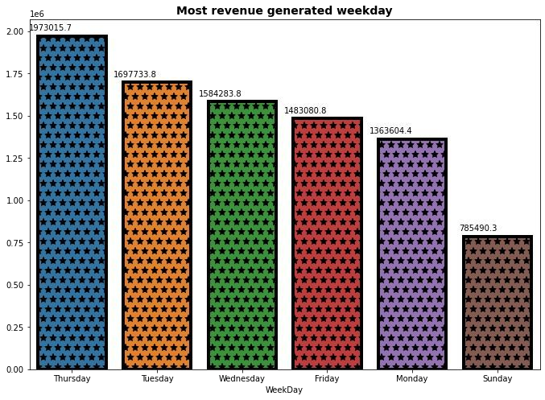
Most revenue generated weekday:
On Thursday Company is generating the highest Revenue
On Sunday company is generating less revenue

Slide 12
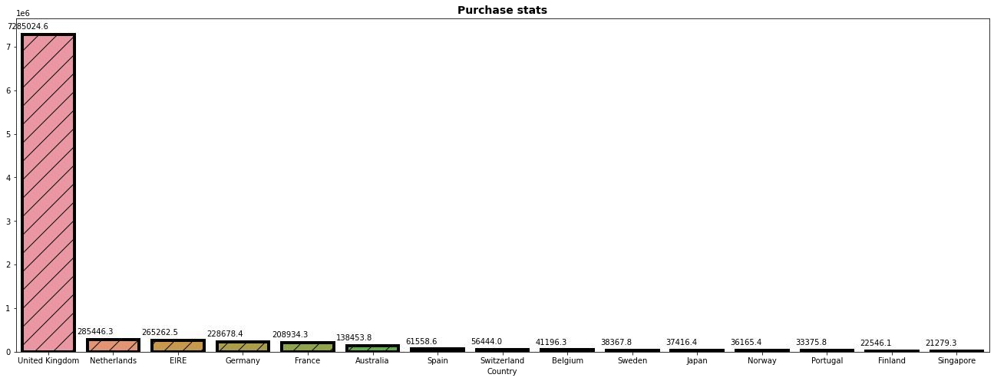
High quantity and high purchasing countries stats:
Here we can see united kingdom is the country which purchase more items as compared to other country.
Singapore is a least purchasing country.

Slide 13
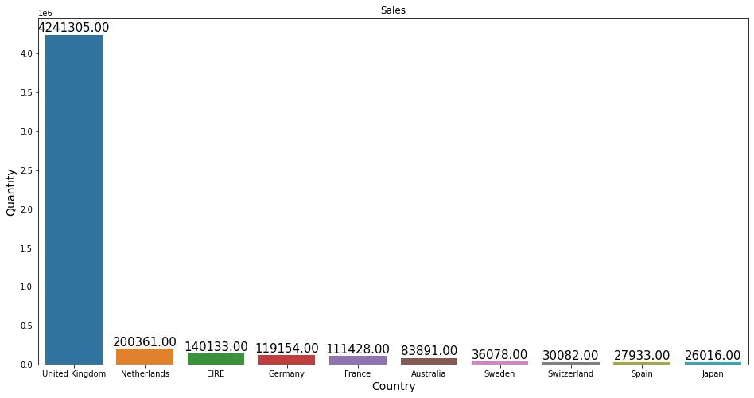
High quantity and high purchasing countries stats:
we can see UK is the country which purchase in high quantity. and japan is a lease purchasing country.

Slide 14
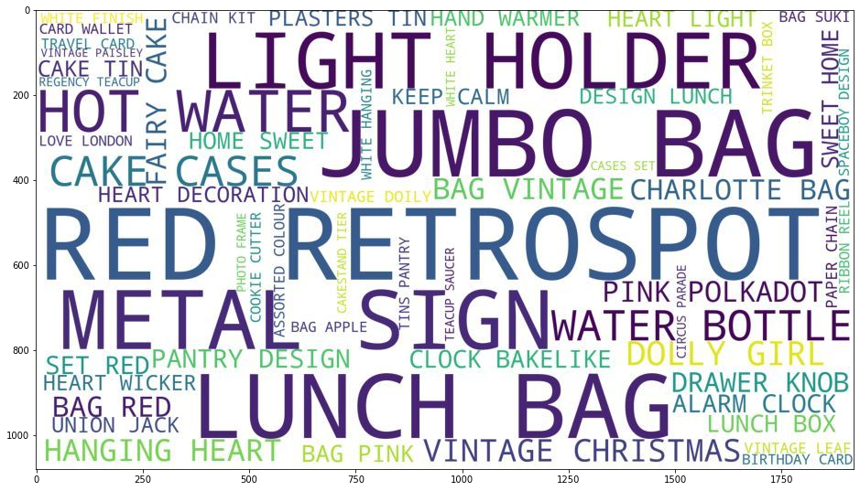
Product Sales Categorization:
Above we can see the product sale categories.

Slide 15
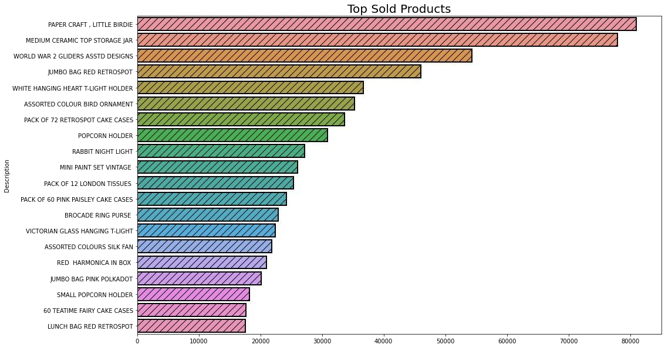
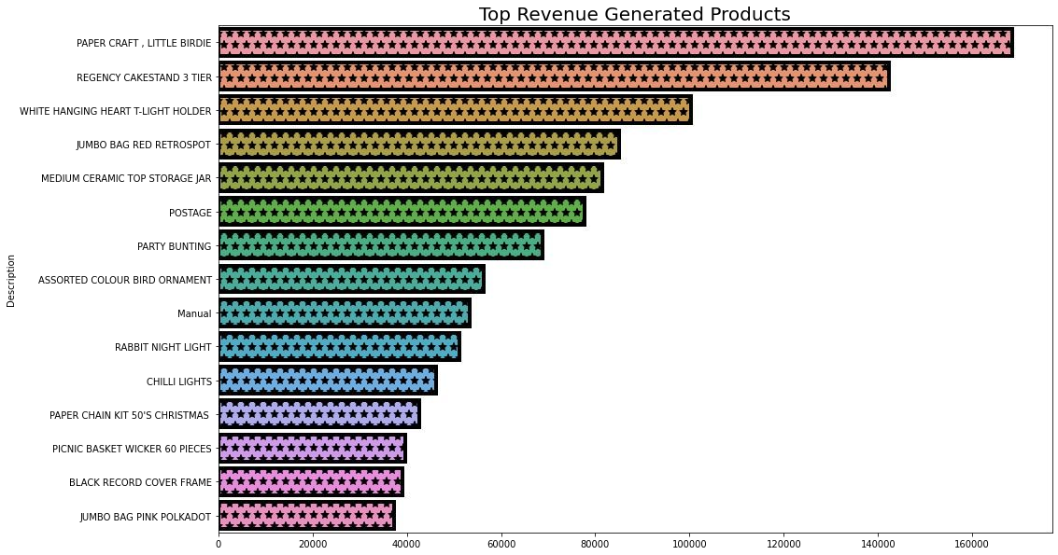
Top sold and revenue generated product:
Here we can see most sold product
Here we can see most revenue generated product is Paper craft, little birdie and least revenue generated product is jumbo bag pink polkadot.
product is Paper craft, little birdie and least sold product is lunch bad red retrospot

Slide 16
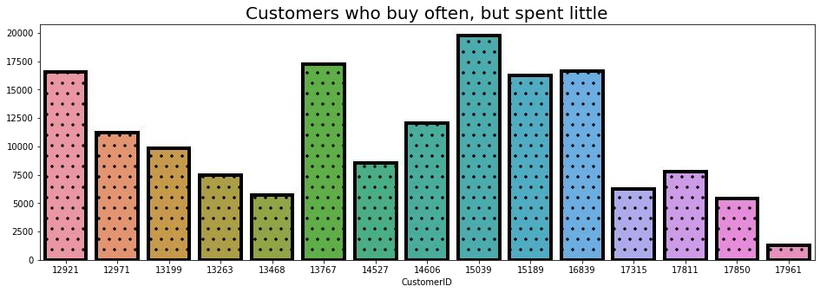
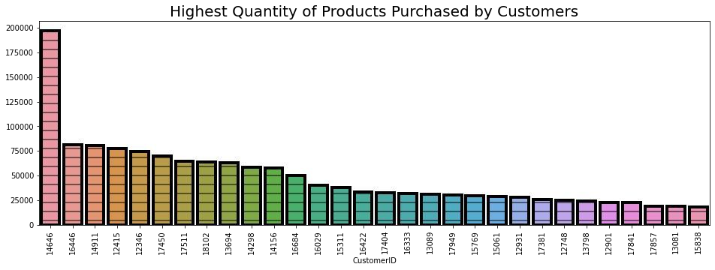
Highest quantity of products purchased by customer and Customers who buy often but spend very little:
Above are the customer id who purchased highest quantity of products.
Above we can see Customers who buy often, but spent little

Slide 17
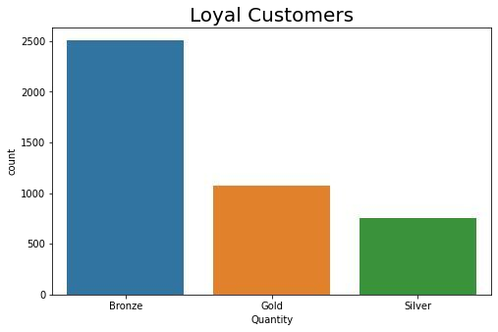
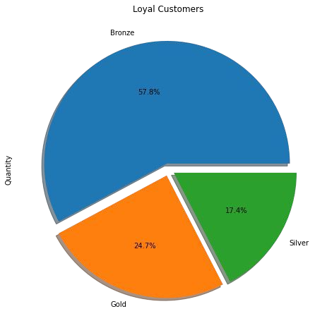
Customers category:
Here we can see we have more no. of bronze customers.

Slide 18
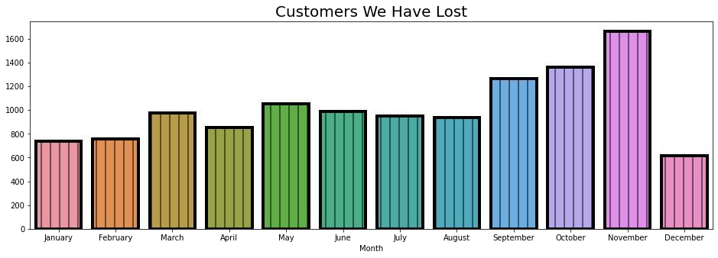
Most customers lost in month:
We can observe that very number of customers are lost visiting the store. At the end of the year many customers are lost.

Slide 19
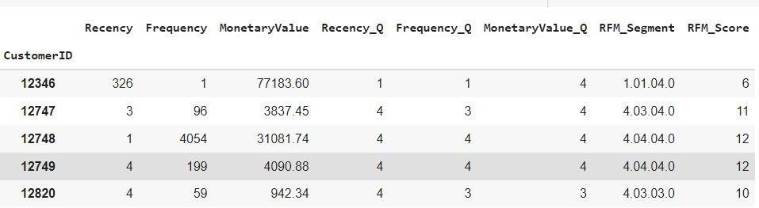
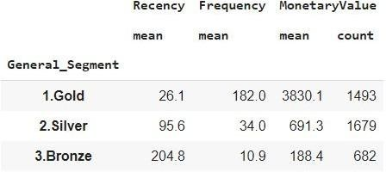
Recency, Frequency and Monetary Value score:

Slide 20
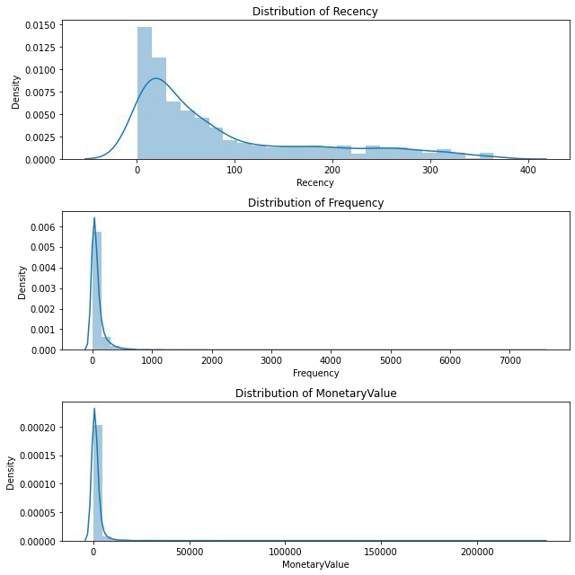
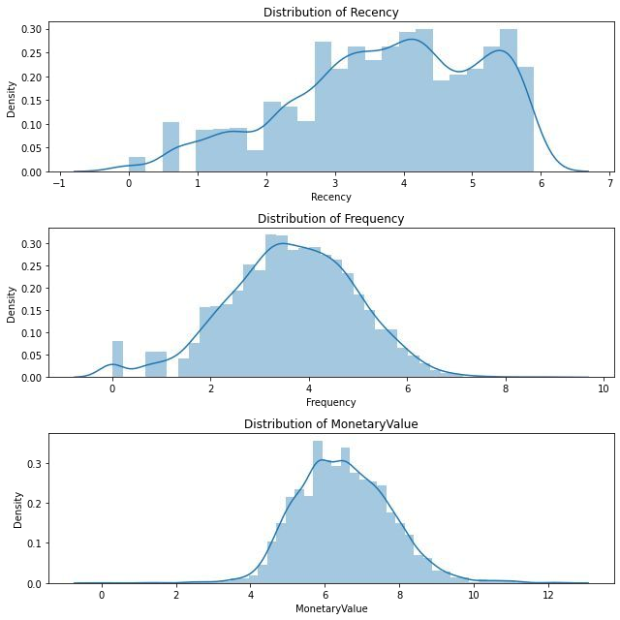
Before and after log transformation:
after log transformation we can see data is normally
Above we can see all the 3 graphs are positively skewed.
distributed(normal distribution).

Slide 21
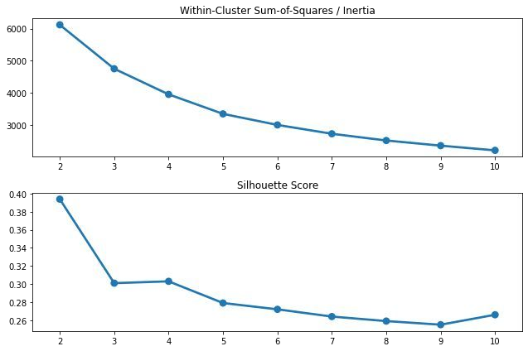
Finding Optimal Cluster:
Based on the inertia and silhouette score, the optimal number of cluster is 3. However, during the implemention of KMeans, cluster of 3, 4, and 5 will be tested to experiment which cluster makes most business sense.

Slide 22
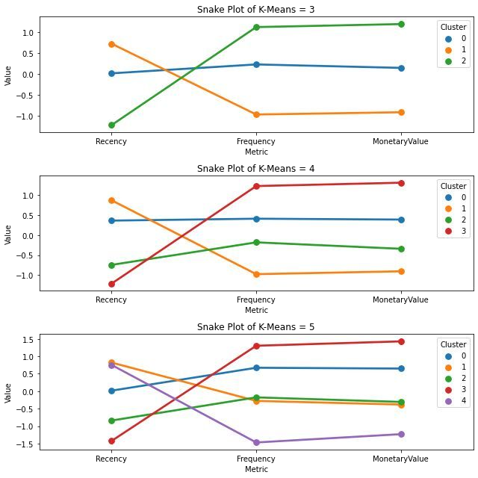
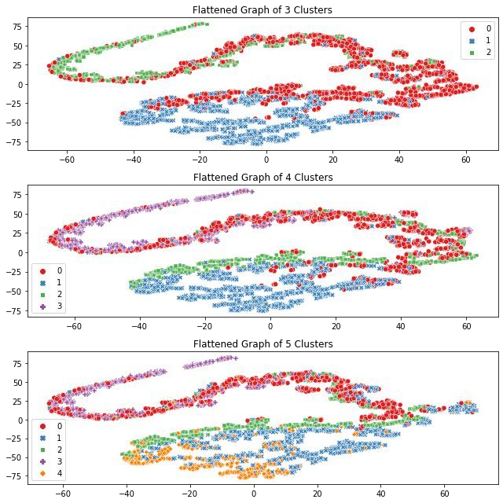
Model used:
★ KMeans Clustering:

Slide 23
Classification models used for prediction:
Logistic Regression:
Random Forest:
XGBoost:
Observation:
I’ve used logistic Regression at first but the score was bit less, after that I’ve used
Tree based algorithm i.e. Random forest and XGBoost and with Random forest I got highest score as compared to other two so, random forest is my optimal model which can be used for further.

Slide 24
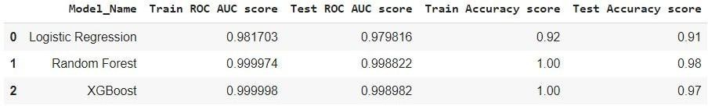
Evaluation Matrix:

Slide 25



Challenges:
Loading dataset takes time.
As there were many null values present in data set it took time to clean the
dataset.
Difficulty in selecting the appropriate graph for trend.

Slide 26

Summary of conclusion:
The customer segments thus deduced can be very useful in targeted marketing, scouting for new customers and ultimately revenue growth. After knowing the types of customers, it depends upon the retailer policy whether to chase the high value customers and offer them better service and discounts or try and encourage low/ medium value customers to shop more frequently or of higher monetary values.

